Slide 1
MNIST Neural Networks
Hyper-parameter search for best MNIST model
John Alexander

Slide 2
Overview
Goal:
Find optimal hyper-parameters for MNIST classification using neural networks
What is the MNIST dataset
General structure of the MNIST neural network model
Hyper-parameter search
Results

Slide 3












MNIST Data
Set of data containing hand-written digits and their corresponding labels as a one-hot encoded arrays
One hot for an image of an 8
Label: 0
Label: 1
Label: 7
Label: 4
0
0
0
0
0
0
0
0
0
1
0
1
2
Label: 2
Label: 8
Label: 5
Label: 3
3
Images:
One hot array:
4
5
6
Label: 4
Label: 6
Label: 6
Label: 9
7
8
9

Slide 4
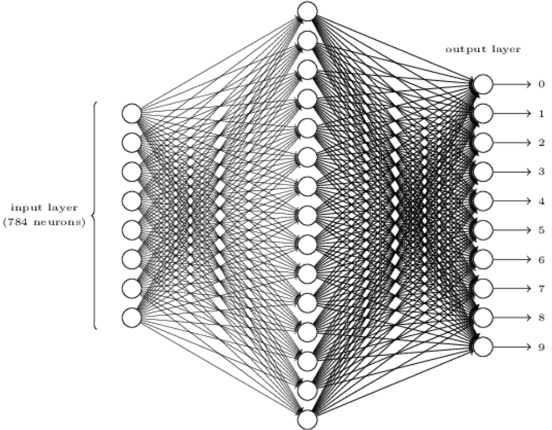
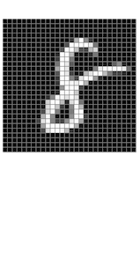
MNIST model
One image at a time is fed into the input layer as 784 pixels, the values propagate through the network and produce a probability at the output layer
hidden layer/s
labels
output
output layer
0
0.1 | 0
0.1 | 0
0.1 | 0
0.2 | 0
0.1 | 0
0.1 | 0
0.3 | 0
0.1 | 0
0.9 | 1
0.2 | 0
1
2
3
input layer
(784 neurons)
4
28
5
6
7
28
8
9
Most likely an 8

Slide 5
Hyper-parameter search
Def. Hyper-parameter
A parameter that is set prior to the training process
Affects the overall performance of the algorithm
To find best model:
Try all combinations of a set of hyper-parameters
Use this set to train model for highest performance

Slide 6
Hyper-parameter search
Constant hyper-parameters:
# of epochs: 20,000
# of classes: 10
Input size: 784 (28 x 28)
Variable hyper-parameters:
Batch size: 1 (On-line), 50 (mini-batch)
# of neurons per layer: 10, 20, 50
# of hidden layers: 1, 2, 5
Learning rates: 0.1, 0.3, 0.5
Activation functions: ReLU, sigmoid, tanh

Slide 7
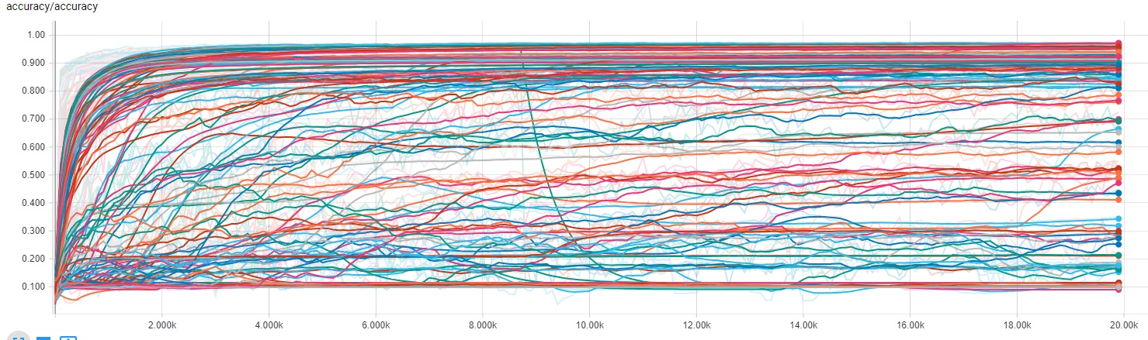

Models
Validation accuracy of 162 Models
Models are validated on every 100th iteration
v$alidation_accuracy=\frac{totalCorrect}{Total}$

Slide 8
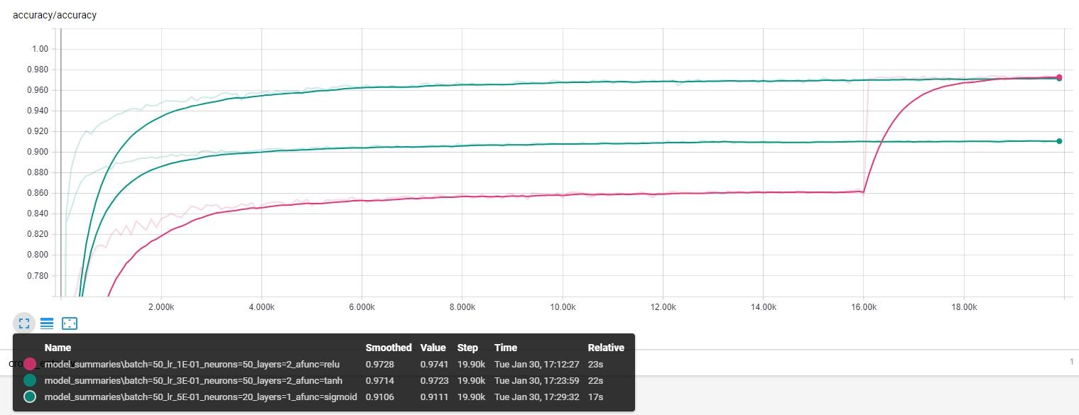
Results (Activation Function)
tanh
sigmoid
ReLU

Slide 9
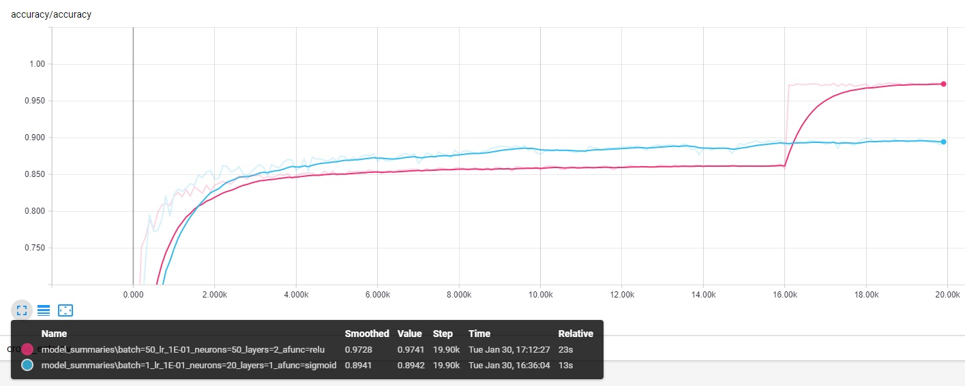
Results (Batch Size)
Batch=50
Batch=1

Slide 10
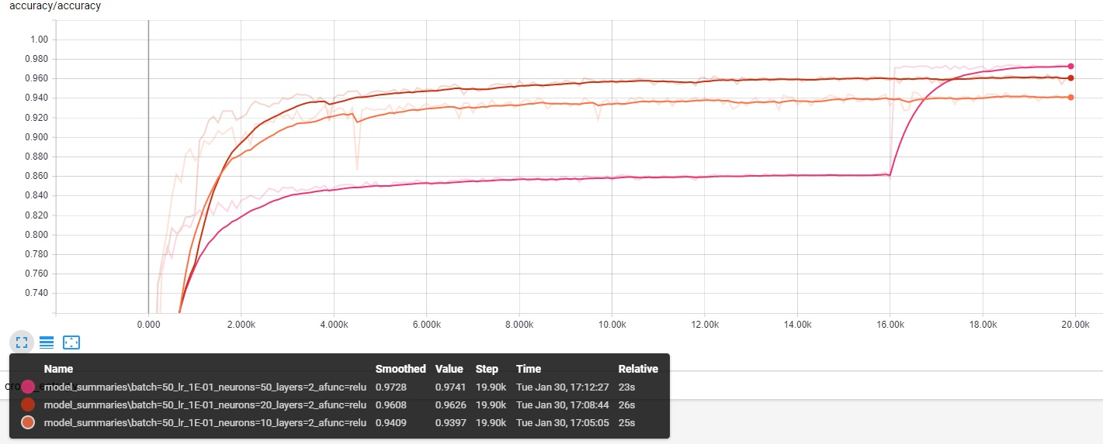
Results (# of neurons)
neurons=20
neurons=10
neurons=50

Slide 11
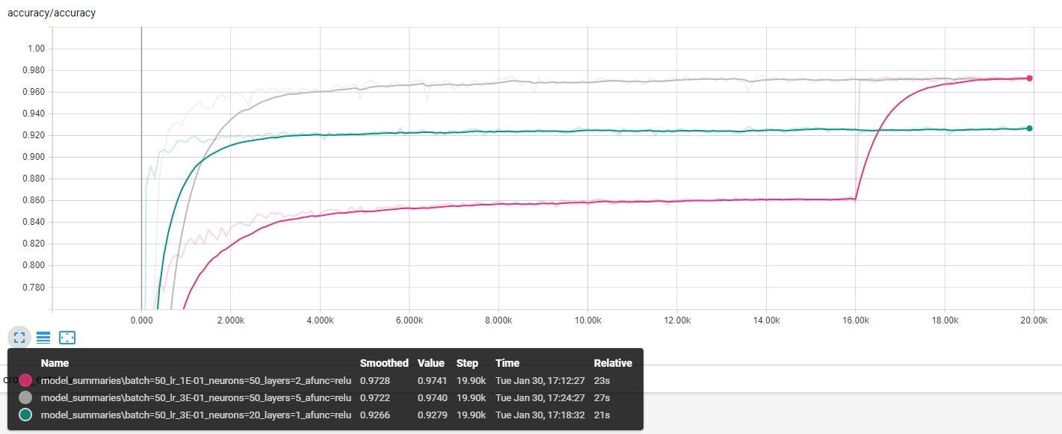
Results (# of layers)
layers=5
layers=1
layers=2

Slide 12
Results
Number of neurons per layer
Number of hidden layers
Learning rate (accuracy)
Learning rate
(error)
Activation Functions
Batch Size
 | ReLU | sigmoid | tanh |  | Batch=1 | Batch=50 |  | neurons=10 | neurons=20 | neurons=50 |  | layers=1 | layers=2 | layers=5 |  | Lr=1E-01 | Lr=3E-01 | Lr=5E-01 |  | Lr=1E-01 | Lr=3E-01 | Lr=5E-01
 | 0.9728 | 0.9106 | 0.9714 |  | 0.8941 | 0.9728 |  | 0.9409 | 0.9608 | 0.9728 |  | 0.9266 | 0.9728 | 0.9722 |  | 0.9728 | 0.9722 | 0.9702 |  | 0.3463 | 0.1691 | 0.2144
 | 0.9722 | 0.9104 | 0.9694 |  | 0.8940 | 0.9722 |  | 0.9351 | 0.9586 | 0.9722 |  | 0.9261 | 0.9721 | 0.9674 |  | 0.9669 | 0.9721 | 0.9694 |  | 0.3465 | 0.2186 | 0.2930
 | 0.9721 | 0.9103 | 0.9674 |  | 0.8929 | 0.9721 |  | 0.9315 | 0.9574 | 0.9721 |  | 0.9252 | 0.9714 | 0.9628 |  | 0.9658 | 0.9714 | 0.9628 |  | 0.3481 | 0.2331 | 0.3158
 | 0.9702 | 0.9091 | 0.9669 |  | 0.8894 | 0.9714 |  | 0.9284 | 0.9548 | 0.9714 |  | 0.9250 | 0.9702 | 0.9574 |  | 0.9608 | 0.9674 | 0.9527 |  | 0.3593 | 0.3121 | 0.3611
 | 0.9608 | 0.9085 | 0.9658 |  | 0.8871 | 0.9702 |  | 0.9252 | 0.9534 | 0.9702 |  | 0.9248 | 0.9694 | 0.9409 |  | 0.9534 | 0.9586 | 0.9508 |  | 0.3877 | 0.5269 | 0.4348
 | 0.9586 | 0.9085 | 0.9628 |  | 0.8836 | 0.9694 |  | 0.9250 | 0.9527 | 0.9694 |  | 0.9242 | 0.9658 | 0.9287 |  | 0.9409 | 0.9574 | 0.9287 |  | 0.4780 | 0.5462 | 0.5000
 | 0.9574 | 0.9029 | 0.9548 |  | 0.8817 | 0.9674 |  | 0.9239 | 0.9508 | 0.9674 |  | 0.9210 | 0.9608 | 0.8778 |  | 0.9250 | 0.9548 | 0.9284 |  | 0.4932 | 0.5726 | 0.6085
 | 0.9572 | 0.9026 | 0.9534 |  | 0.8813 | 0.9669 |  | 0.9186 | 0.9409 | 0.9669 |  | 0.9186 | 0.9586 | 0.8600 |  | 0.9248 | 0.9409 | 0.9252 |  | 0.8065 | 0.6034 | 0.8998
 | 0.9409 | 0.9023 | 0.9508 |  | 0.8810 | 0.9658 |  | 0.9184 | 0.9287 | 0.9658 |  | 0.9184 | 0.9548 | 0.8422 |  | 0.9242 | 0.9351 | 0.9210 |  | 0.9706 | 0.9179 | 0.9136
 | 0.9351 | 0.9019 | 0.9409 |  | 0.8803 | 0.9628 |  | 0.9169 | 0.9266 | 0.9628 |  | 0.9182 | 0.9534 | 0.8265 |  | 0.9239 | 0.9315 | 0.9186 |  | 1.0050 | 0.9184 | 0.9184
 | 0.9284 | 0.9000 | 0.9315 |  | 0.8766 | 0.9608 |  | 0.9156 | 0.9248 | 0.9261 |  | 0.9180 | 0.9527 | 0.6652 |  | 0.9164 | 0.9266 | 0.9182 |  | 1.0260 | 0.9445 | 0.9387
 | 0.9266 | 0.8941 | 0.9287 |  | 0.8725 | 0.9586 |  | 0.9103 | 0.9186 | 0.9242 |  | 0.9174 | 0.9508 | 0.4901 |  | 0.9159 | 0.9261 | 0.9180 |  | 1.0500 | 1.0070 | 1.0060
 | 0.9261 | 0.8940 | 0.9239 |  | 0.8621 | 0.9574 |  | 0.9085 | 0.9182 | 0.9210 |  | 0.9169 | 0.9409 | 0.4871 |  | 0.9156 | 0.9186 | 0.9169 |  | 1.0520 | 1.0160 | 1.0070
 | 0.9252 | 0.8929 | 0.9186 |  | 0.8599 | 0.9548 |  | 0.9023 | 0.9164 | 0.9174 |  | 0.9164 | 0.9351 | 0.2732 |  | 0.9029 | 0.9184 | 0.9106 |  | 1.0530 | 1.0160 | 1.0070
 | 0.9250 | 0.8894 | 0.9186 |  | 0.8522 | 0.9534 |  | 0.8940 | 0.9106 | 0.9159 |  | 0.9159 | 0.9315 | 0.2132 |  | 0.9023 | 0.9174 | 0.9104 |  | 1.1850 | 1.0170 | 1.0330
average: | 0.9486 | 0.9025 | 0.9483 |  | 0.8792 | 0.9651 |  | 0.9196 | 0.9382 | 0.9530 |  | 0.9208 | 0.9574 | 0.7510 |  | 0.9341 | 0.9446 | 0.9335 |  | 0.7271 | 0.6679 | 0.6967
std: | 0.0195 | 0.0072 | 0.0196 |  | 0.0127 | 0.0067 |  | 0.0125 | 0.0181 | 0.0238 |  | 0.0040 | 0.0135 | 0.2612 |  | 0.0240 | 0.0212 | 0.0215 |  | 0.3337 | 0.3268 | 0.3123

Slide 13
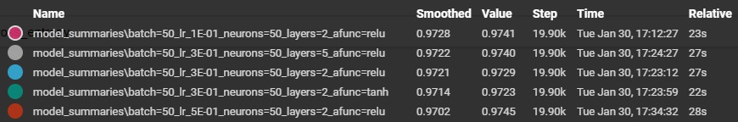
Conclusion
Considering the top five best performing models we can see:
4 out of 5 are using ReLU activation function
4 out of 5 have 2 hidden layers
5 out of 5 have 50 neurons
4 out of 5 have a learning rate of 0.3
5 out of 5 are using batch size of 50
Therefore, can conclude that using these hyper-parameters will most likely yield the best accuracy for classification of the MNIST dataset using a neural network
Top 5 highest validation accuracy:

Slide 14
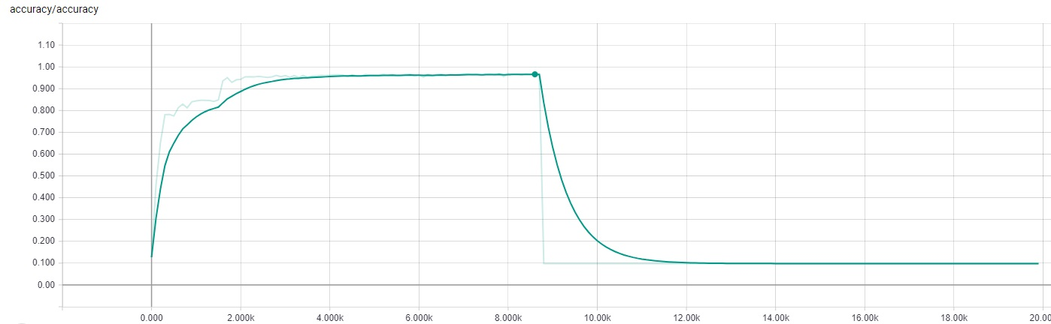
Bonus Points
One model fell rapidly in accuracy during training
Vanishing gradient problem? where the gradient becomes too small to compute ( this is my guess )

